Slide 1
Modern Java
Utrecht, March 2025
Ron Veen

Slide 2
Agenda
Virtual threads
Structured Concurrency
Scoped Values
4. Record patterns
5. Unnamed patterns and variables
6. Unnamed patterns
7. Primitive patterns
8. Sequenced Collections
9. Statements before super
10. Stream Gatherers
11. Generational ZGC
12. Unnamed class and instance main methods.
13. Module Imports
14. Launch multi-file source code programs
15. Markdown Documentation
Faster
Better
Easier

Slide 3
Virtual Threads

Slide 4
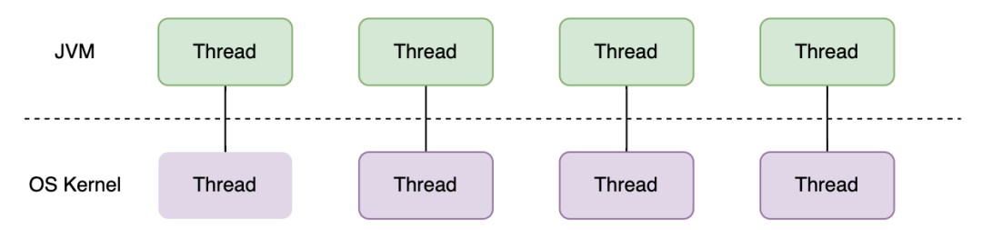
Java Threads

Slide 5
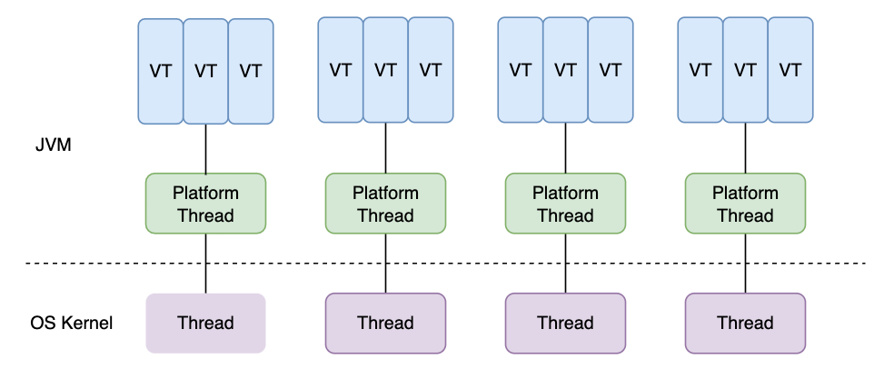
Virtual Threads

Slide 6
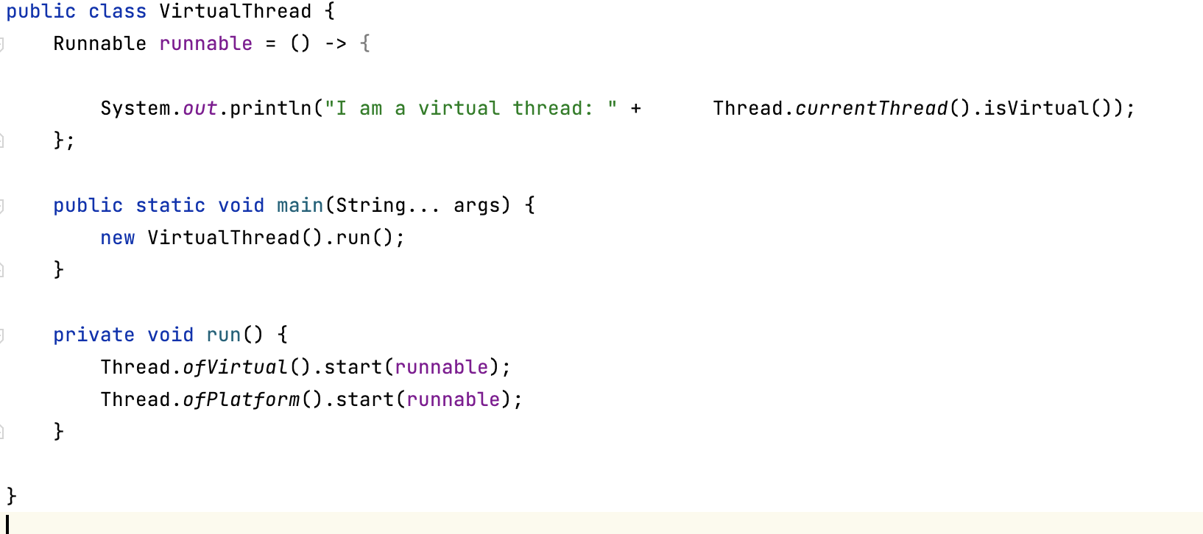
Factory methods

Slide 7
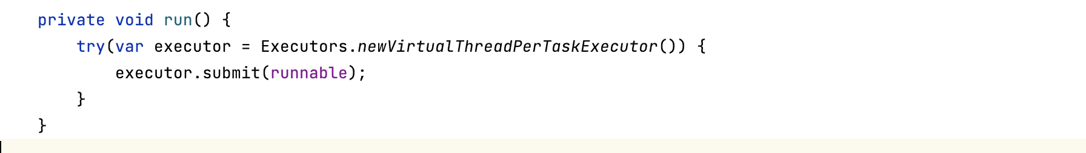
Virtual Thread Per Task Executor

Slide 8
Structured Concurrency

Slide 9
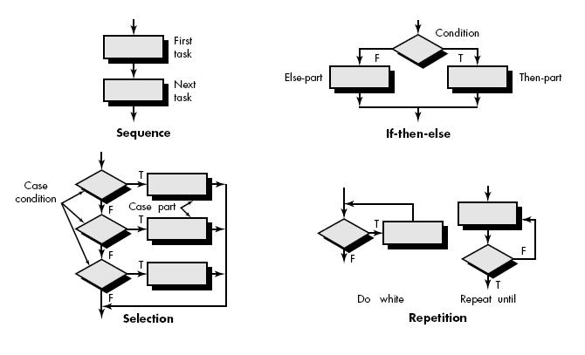
Structured Concurrency

Slide 10
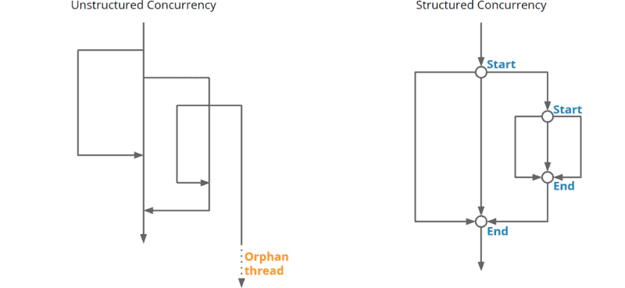
Structured Concurrency

Slide 11
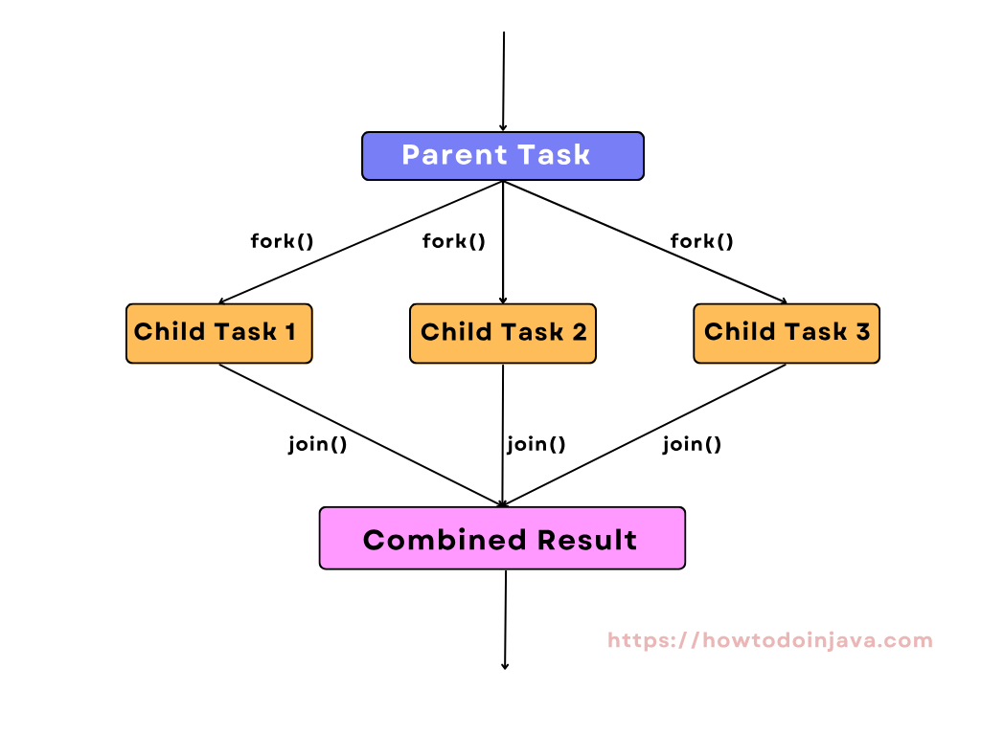
Structured Concurrency

Slide 12
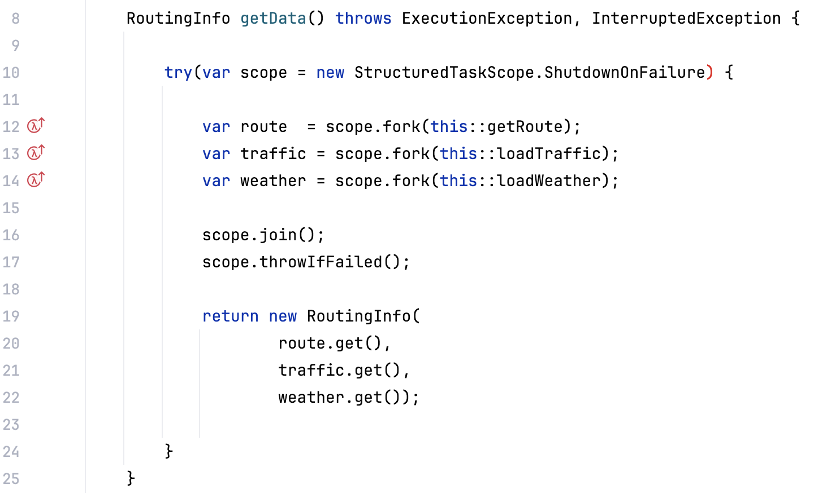
Invoke All pattern

Slide 13
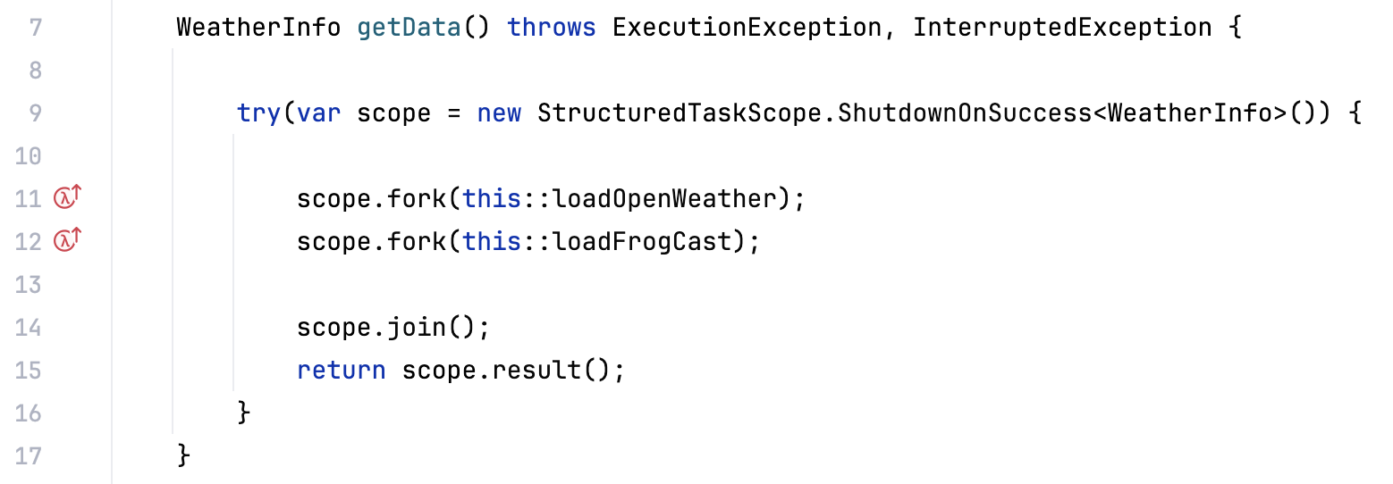
Invoke Any pattern

Slide 14
Scoped Values

Slide 15
Thread Locals
Share information between different components of your application
Create a ThreadLocal instance that is reachable from anywhere
You can provide an initial value on creation
Or set a value using set (T value)
Retrieve the value anywhere via get( )

Slide 16
The problem with Thread Locals
Mutable
Resource intensive
Leaking

Slide 17
Enter Scoped Values
Exist for a limited time (lifetime of the Runnable)
Only the thread that wrote the value can read it
Immutable
Passed by reference

Slide 18
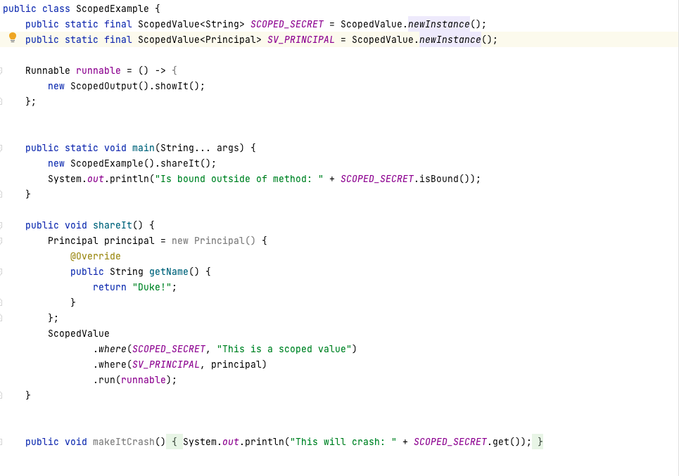
Scoped Values

Slide 19
Record Pattern Matching

Slide 20
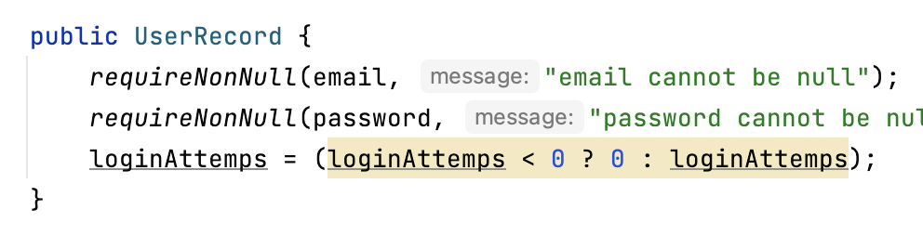
Records

Slide 21
Sealed classes

Slide 22
Pattern Matching
Predicate
Object to test against
Pattern variables
Flow scope

Slide 23
Pattern Matching: Instanceof
Predicate ==> instanceof Approver
Object to test against ==> user
Pattern variables ==> a
Flow scope ==> between { }

Slide 24
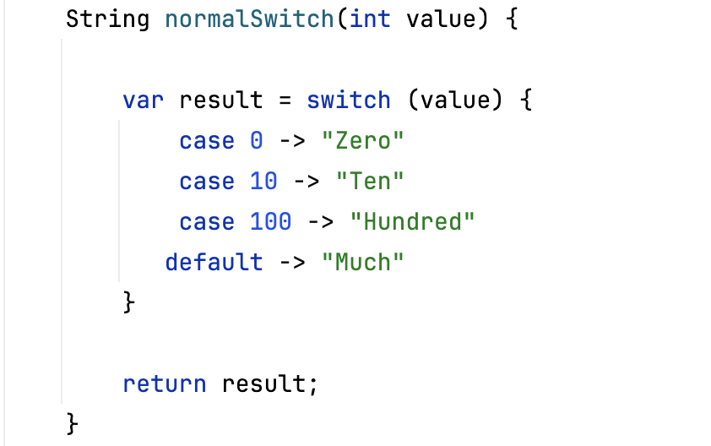
Switch Pattern Matching

Slide 25
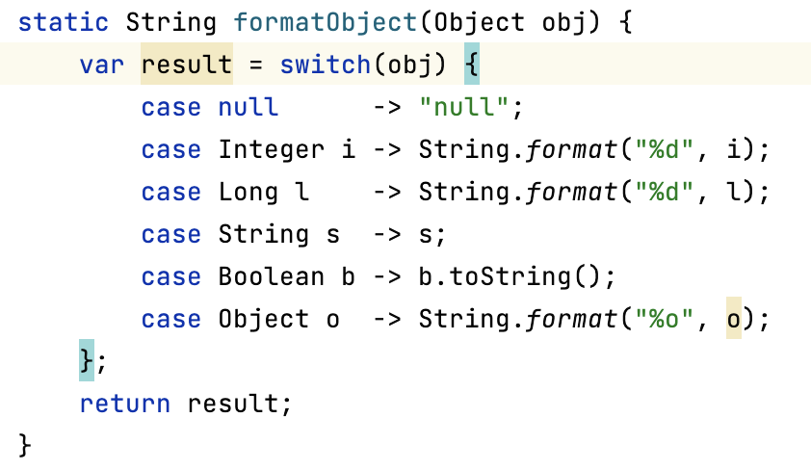
Switch Pattern Matching

Slide 26
Switch Pattern Matching

Slide 27
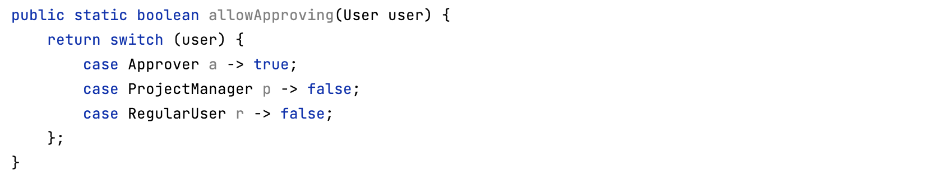
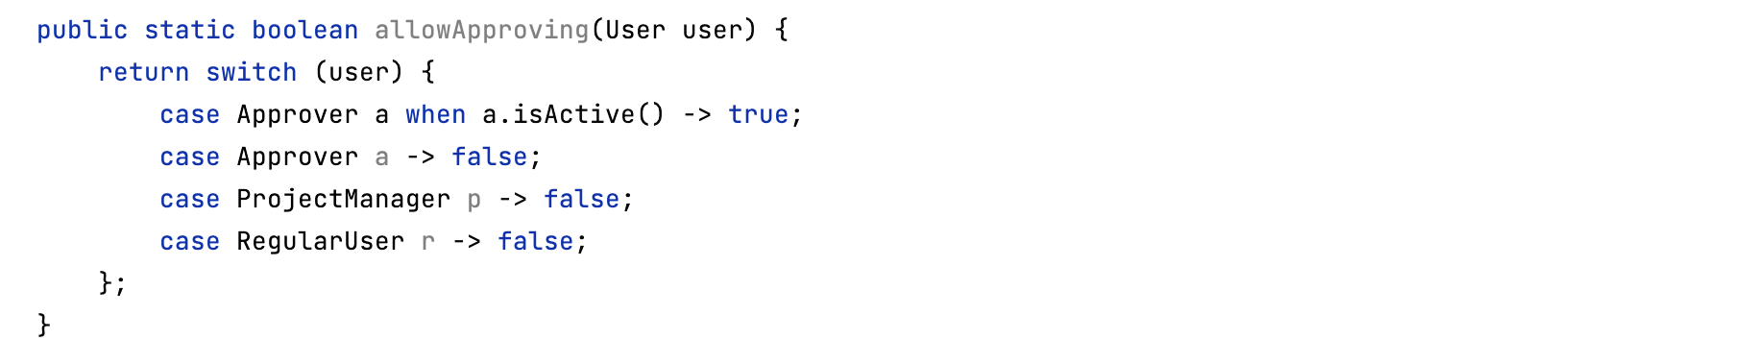
Pattern Matching: switch

Slide 28
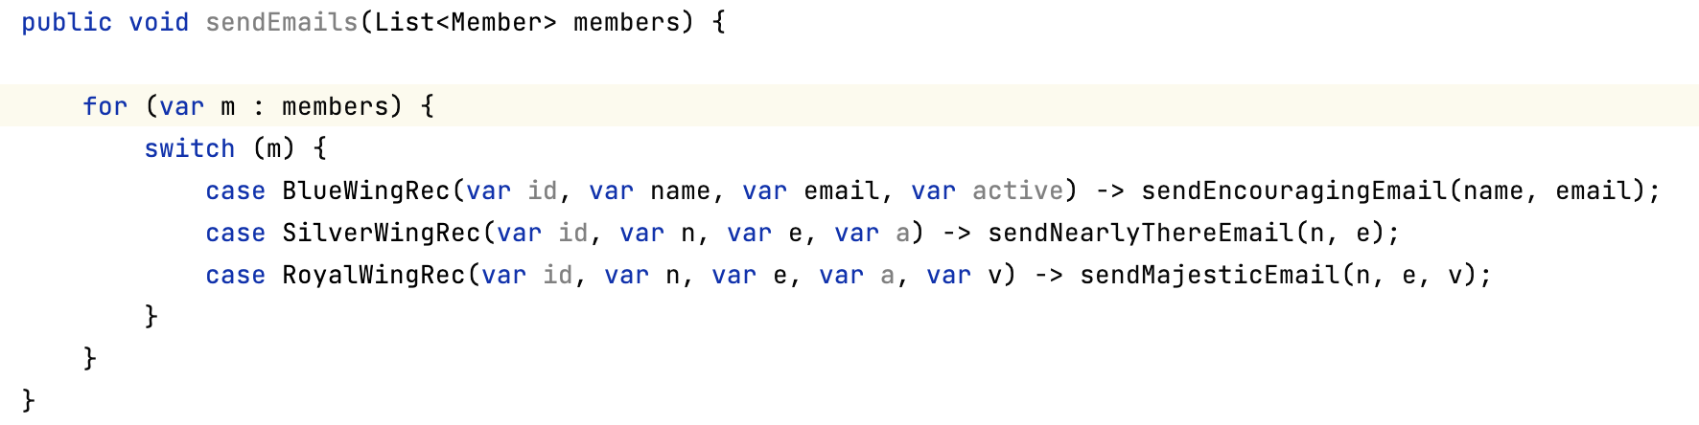
Record Pattern Matching

Slide 29
Record Pattern Matching
Checks if the object is of type BlueWingRec
If so:
Create 4 local variables
Long id
String name
String email
Boolean active
Assigns the value if BlueWingRec.id to id
Assigns the value of BlueWingRec.name to name
Assigns the value of BlueWingRec.email to email
Assigns the value of BlueWingRec.active to active

Slide 30
Unnamed Patterns And Variables

Slide 31
Unnamed Patterns And Variables

Slide 32
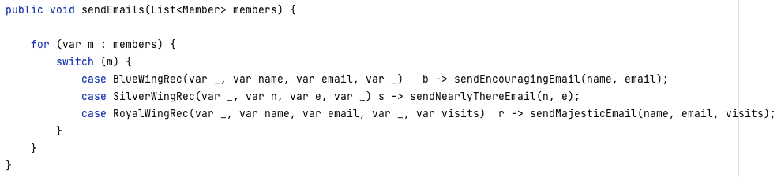
Unnamed Patterns And Variables

Slide 33
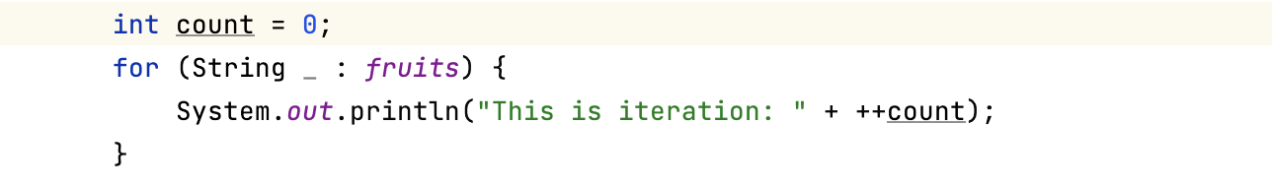

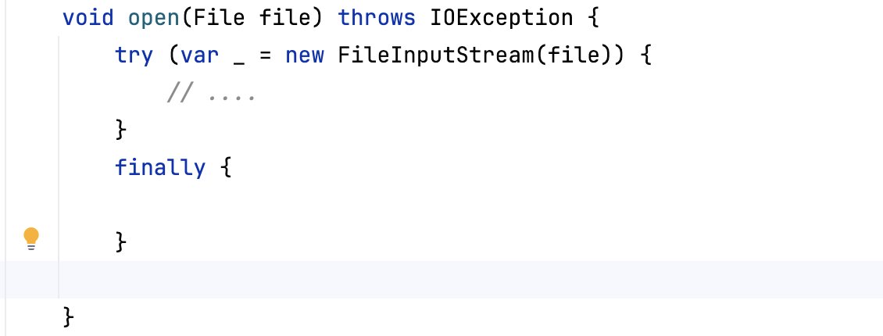
Unnamed Patterns And Variables

Slide 34
Primitive Patterns, InstanceOf, And Switch

Slide 35
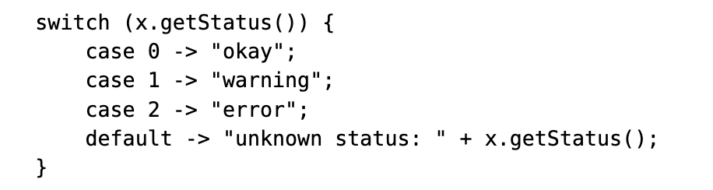
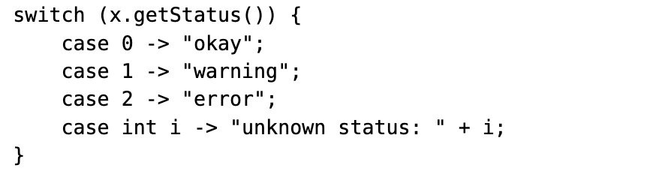
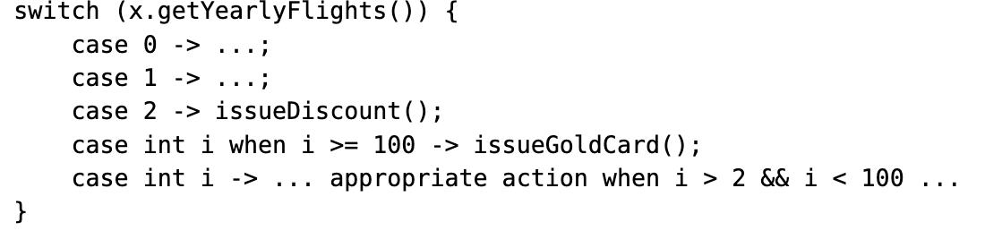
Primitive In Patterns, InstanceOf, And Switch

Slide 36
Sequenced Collections

Slide 37
Sequenced Collections

Slide 38
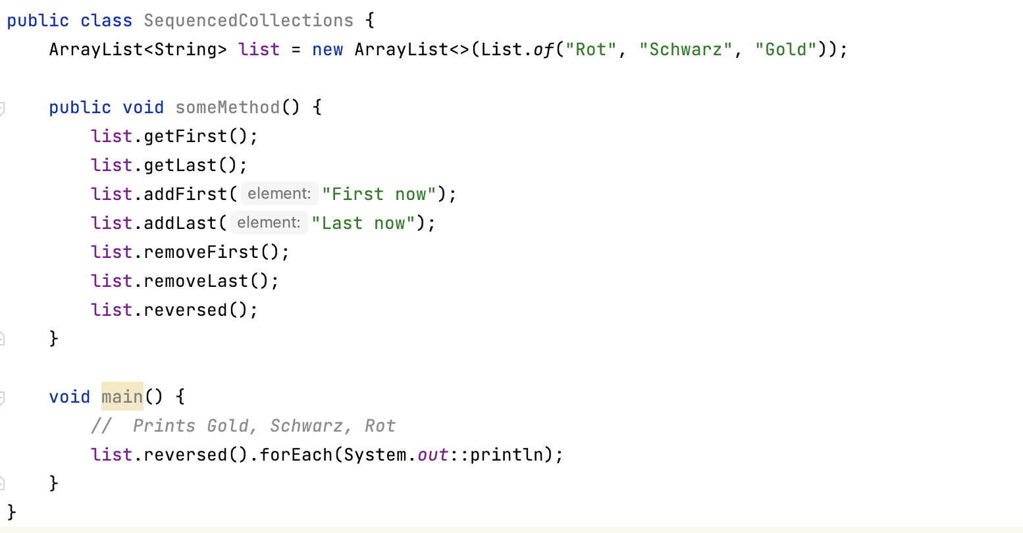
Sequenced Collections

Slide 39
Flexible Constructor Bodies
(Statements Before Super)

Slide 40
Statements Before Super
Object
super( )
Parent
super( )
Child

Slide 41
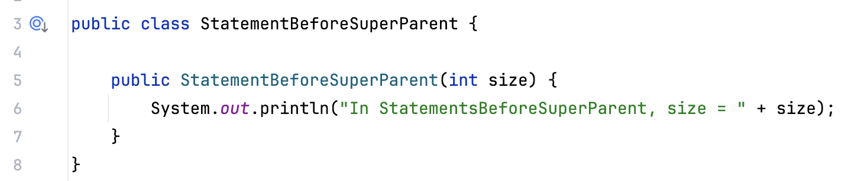
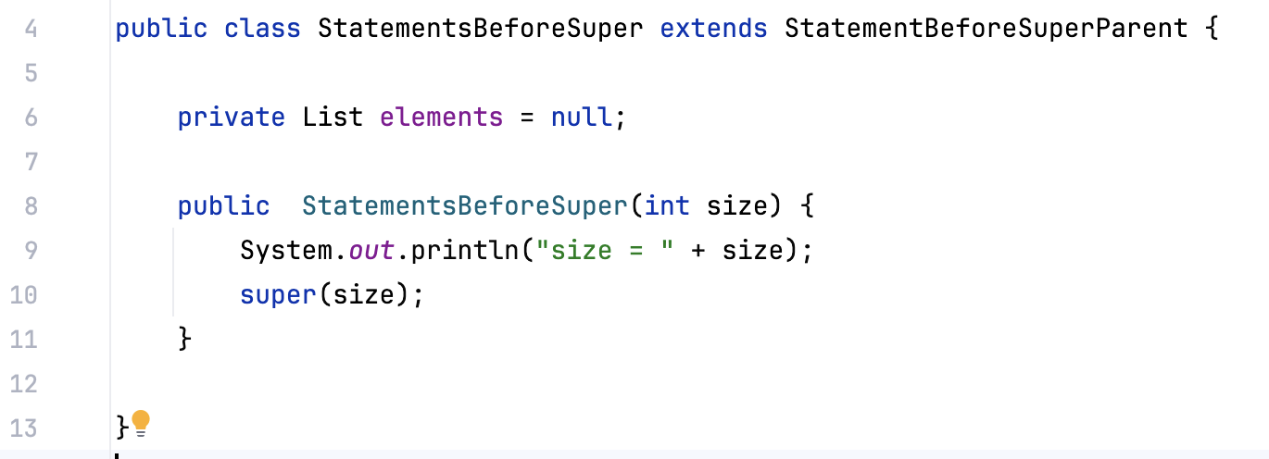
Statements Before Super

Slide 42
Stream Gatherers

Slide 43
Stream setup
List.of("One", "Two", "Three", "Four", "Five")
.stream()
.filter(e -> !e.startsWith("T"))
.map(e -> e.toUpperCase())
.collect(Collectors.toList());

Slide 44
Stream sources
Collections types
Stream.of

Slide 45
Terminal Operations
findFirst, findAny, etc.
min, max
Collectors.toCollection
Collectors.toMap, Collectors.toList
toList
Implement your own via implementing the Collector interface

Slide 46
Intermediate Operations
limit
filter
map
flatMap
takeWhile
dropWhile
skip
sorted
distinct

Slide 47
New Intermediate Operations
mapConcurrent
fold
scan
windowFixed
windowSliding

Slide 48
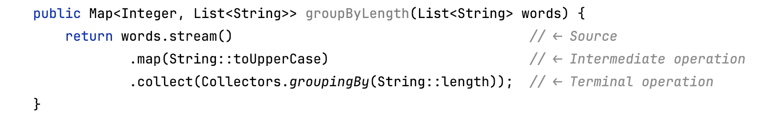
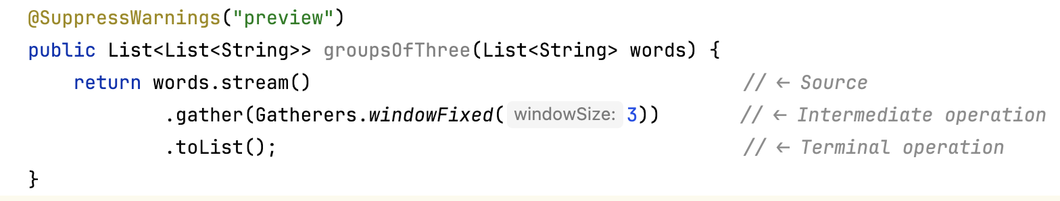
Stream Gatherers

Slide 49
Stream Gatherers
Initializer
Integrator
Finisher
Combiner

Slide 50
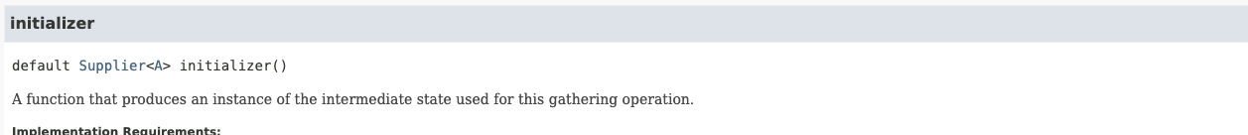
Gatherer API

Slide 51
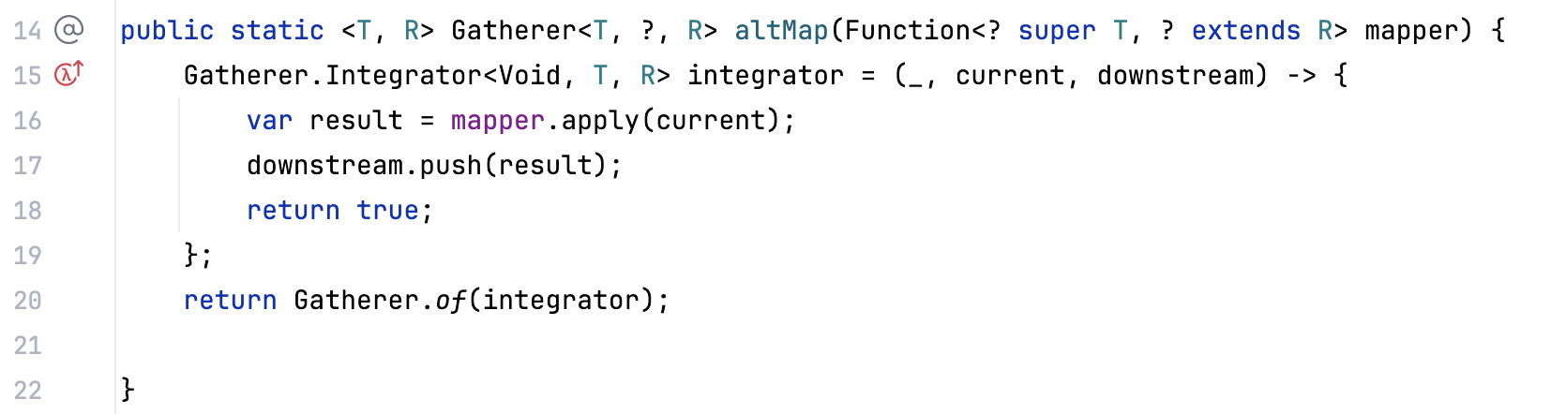
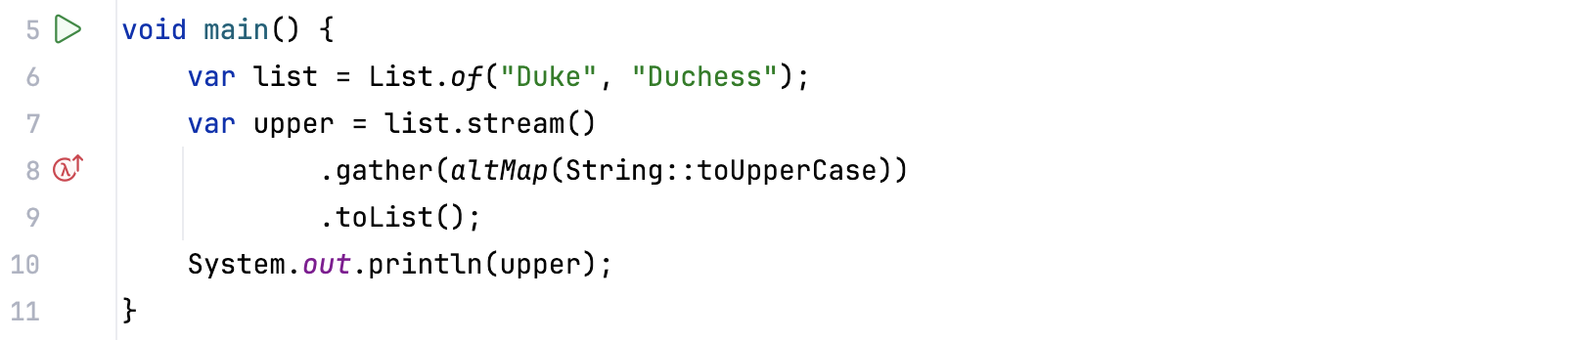

Create our own Map operation (stateless)

Slide 52


Create our own Limit (Stateful)
Make a custom Gatherer
Takes a Stream of any Type
Returns only the first n elements

Slide 53
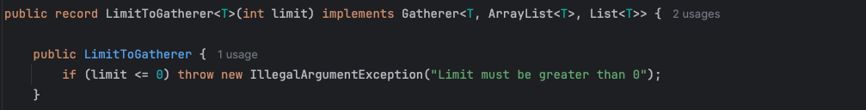
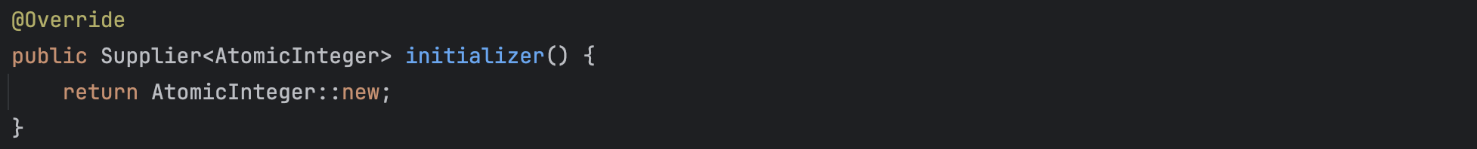
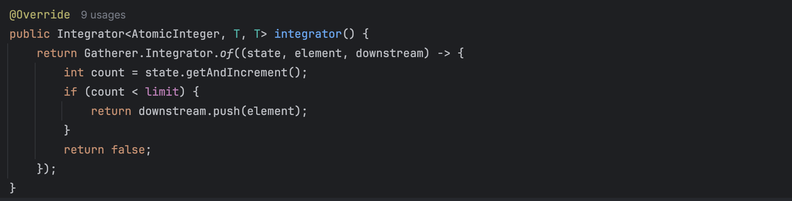
Example

Slide 54
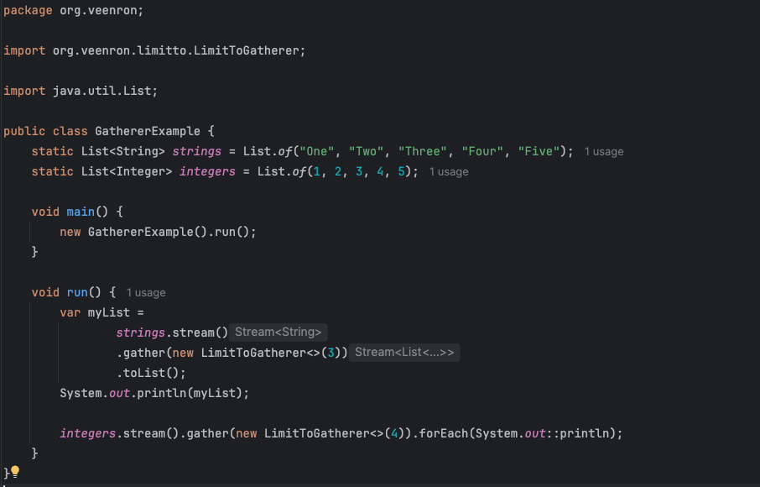
Example

Slide 55
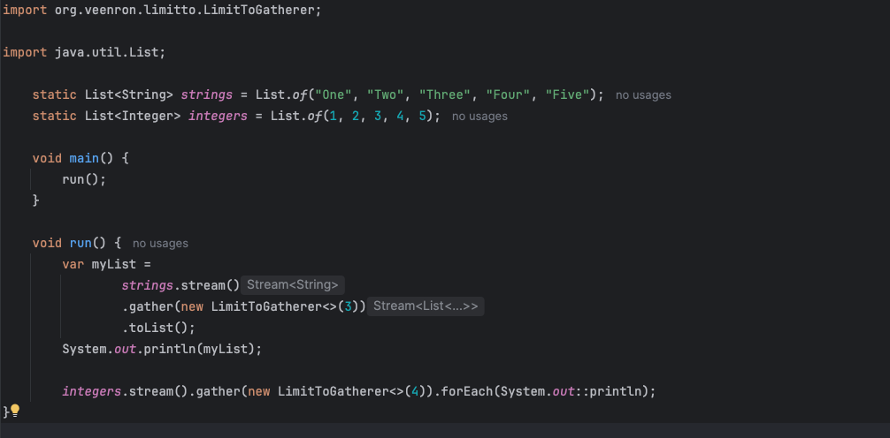
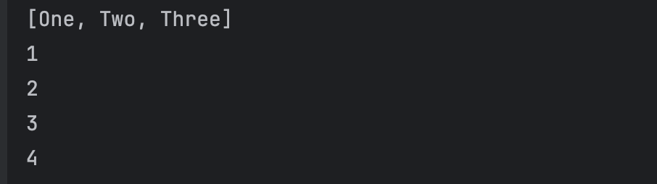
Example

Slide 56
Generational ZGC

Slide 57
Generational ZGC
Based on ZGC
Pause times lower than one millisecond
Support for heap sizes up yo many terabytes
Minimal manual configuration
Reduced risk of allocation stalls
Decreased heap memory overhead requirements
Lowered garbage collection CPU overhead

Slide 58
Generational ZGC
Weak generational hypothesis
Two-generation heap structure
Young generation
Old generation
Now the default mode ZGC
java -XX:+ZGenerational

Slide 59
Unnamed Classes and Instance Main Methods
(Implicitly Declared Classes And Instance Main Methods)

Slide 60
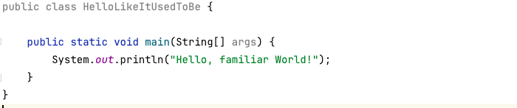
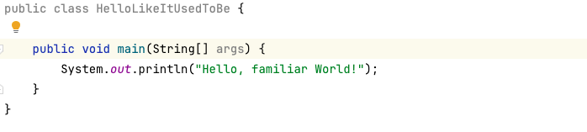
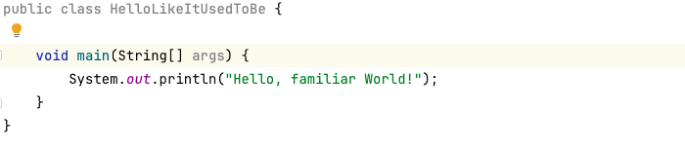
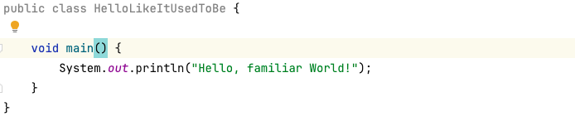
Unnamed Classes And Instance Main Methods

Slide 61
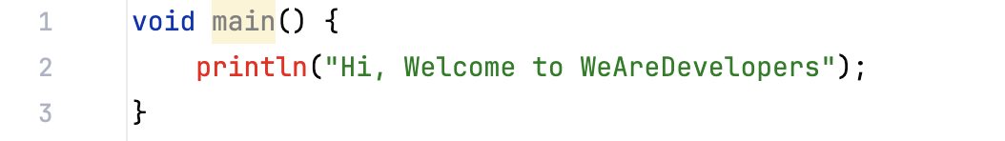
Unnamed Classes And Instance Main Methods

Slide 62
Module Imports

Slide 63
Module Imports
Explicitly import classes -> import java.Util.List
Import with wildcards -> import java.util.*
Import everything in a module
Import module java.base would import 54 on-demand package imports

Slide 64
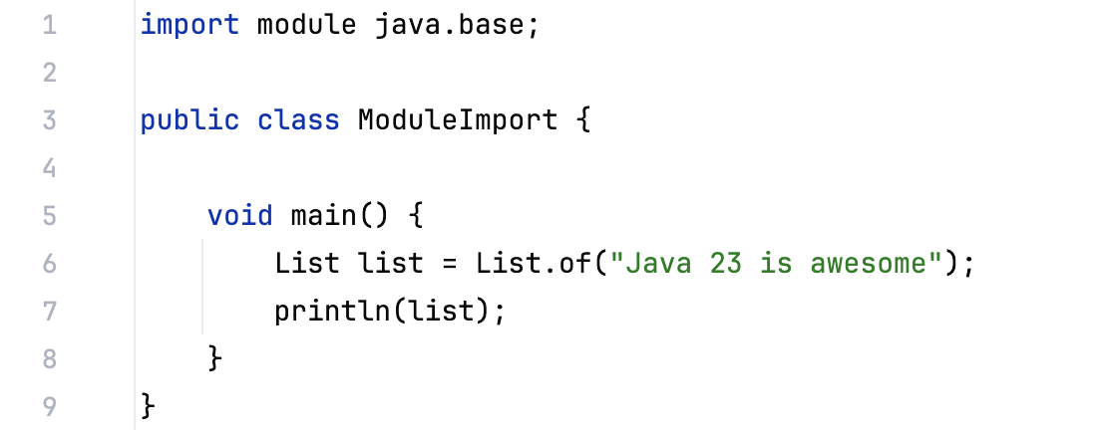
Module Imports

Slide 65
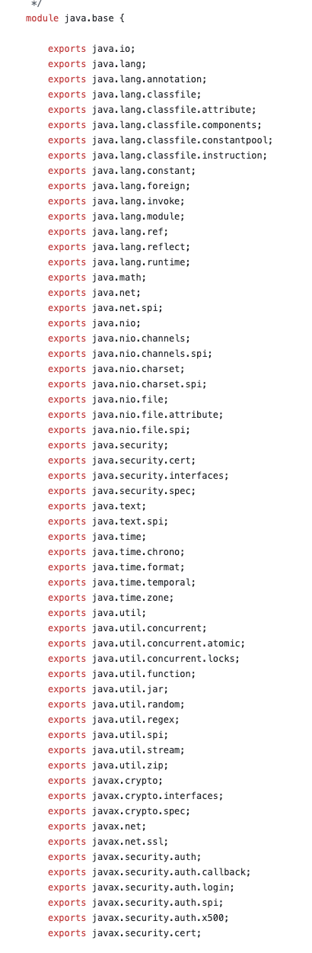
Module Imports

Slide 66
Launch Multi-File Source Code Program

Slide 67
Launch Multi-File Source Code Program
Running source file from java was introduced in Java 11
Does not require the source code to be compiled into byte code upfront
Compiles the source code to memory and executes the main method
Only direct java directly referenced java files are included

Slide 68
Markdown Documentation Comments

Slide 69
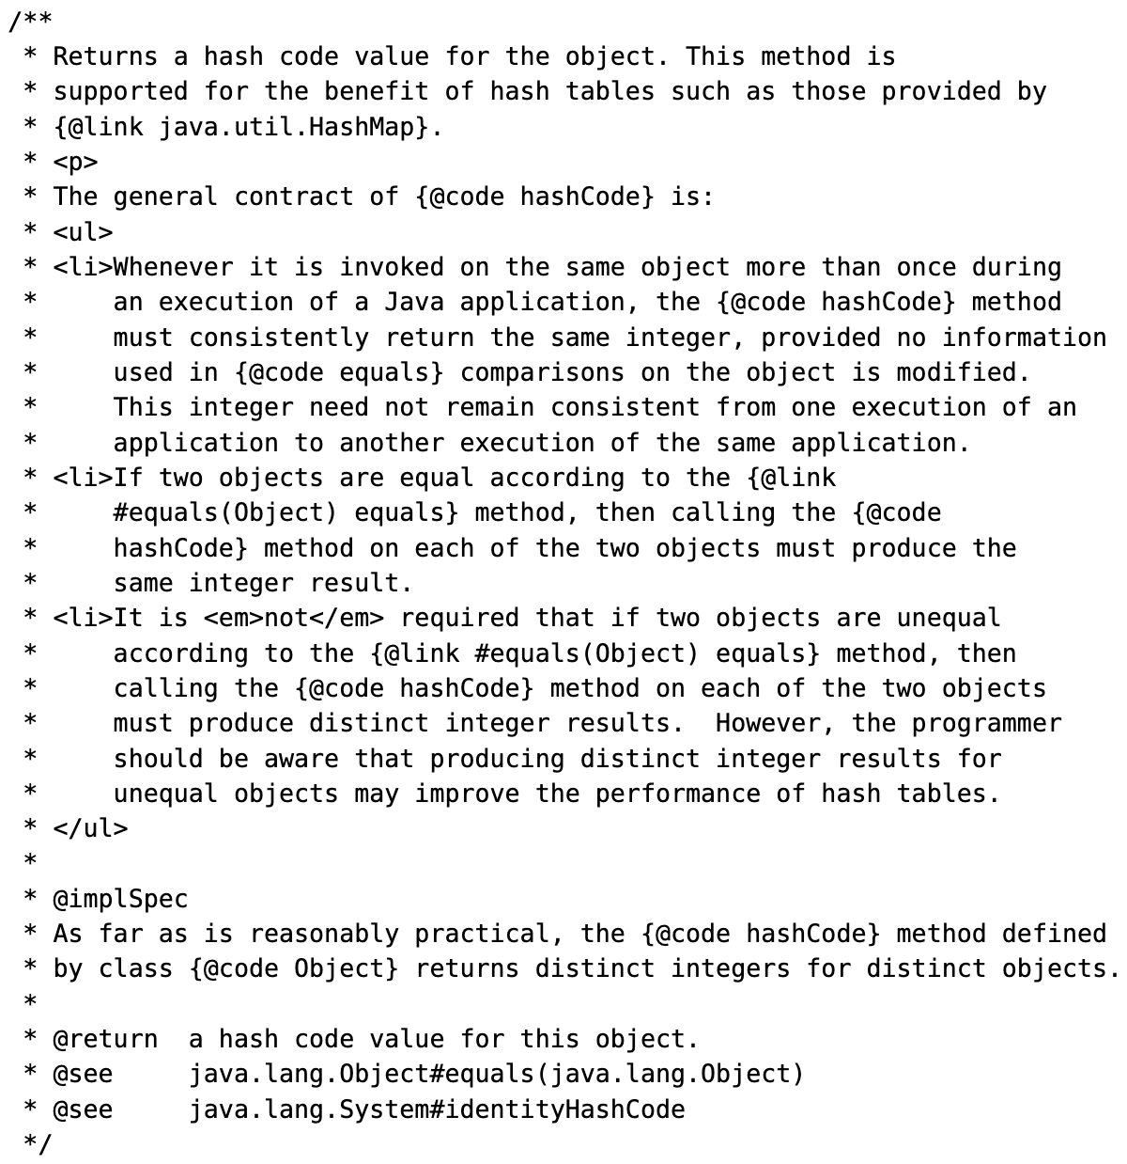
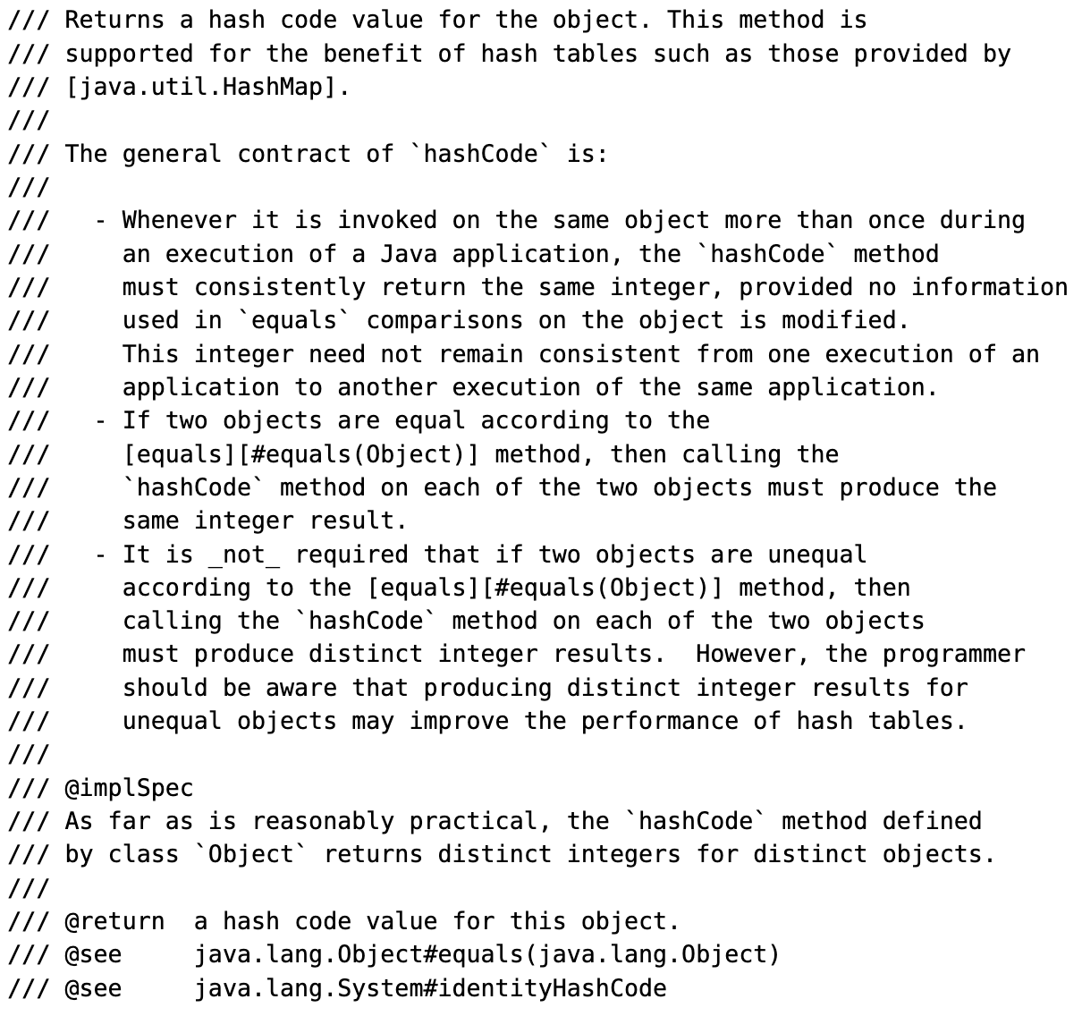
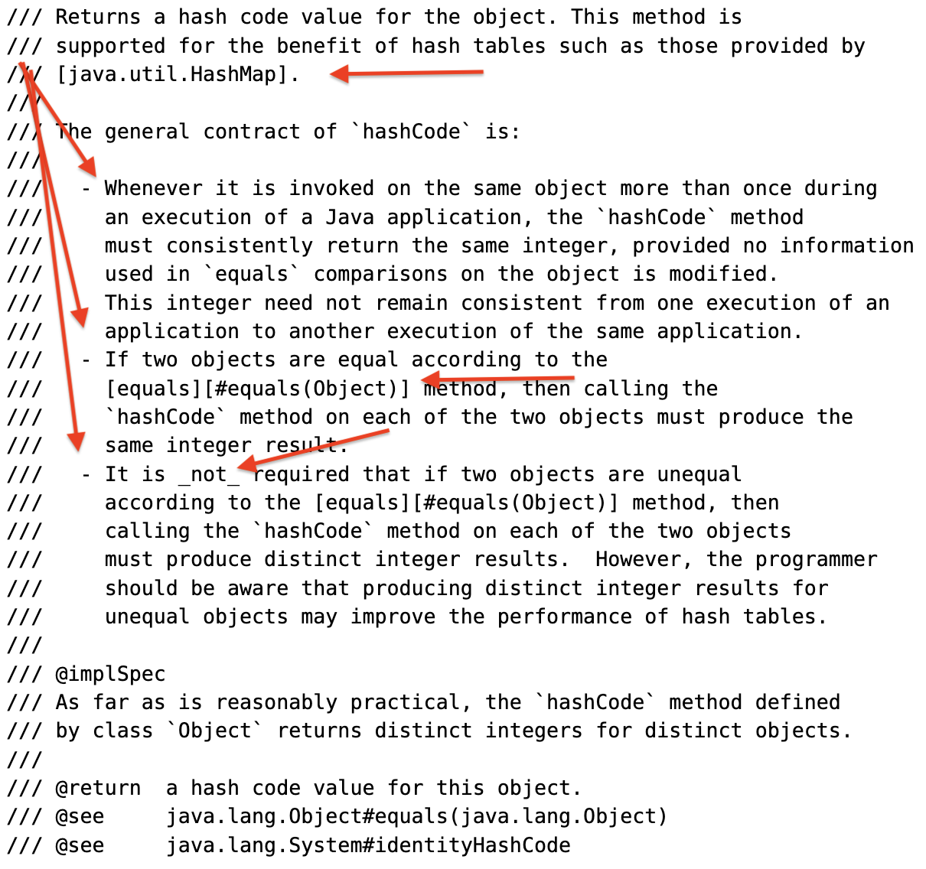
Markdown Documentation Comments

Slide 70





Who is Ron Veen
Java developer for 20+ years
Special Agent @ Team Rockstars IT
Author:
Migrating to cloud-native Jakarta EE
Project Loom
@ronveen
@ronveen
.bsky.social
ronveen
@ronveen@foojay.social

